Slide 1
Chapters 6, 7 and 8
Data Types
Expressions and Assignment Structures
Statement-Level Control Structures

Slide 2
Chapter 6
Data Types
Primitive Data Types
User_Defined Ordinal Types
Array Types
Record types
Union Types
Set Types
Pointer Types
Notes:
The slides for this text are organized into chapters. This lecture covers Chapter 1.
Chapter 1: Introduction to Database Systems
Chapter 2: The Entity-Relationship Model
Chapter 3: The Relational Model
Chapter 4 (Part A): Relational Algebra
Chapter 4 (Part B): Relational Calculus
Chapter 5: SQL: Queries, Programming, Triggers
Chapter 6: Query-by-Example (QBE)
Chapter 7: Storing Data: Disks and Files
Chapter 8: File Organizations and Indexing
Chapter 9: Tree-Structured Indexing
Chapter 10: Hash-Based Indexing
Chapter 11: External Sorting
Chapter 12 (Part A): Evaluation of Relational Operators
Chapter 12 (Part B): Evaluation of Relational Operators: Other Techniques
Chapter 13: Introduction to Query Optimization
Chapter 14: A Typical Relational Optimizer
Chapter 15: Schema Refinement and Normal Forms
Chapter 16 (Part A): Physical Database Design
Chapter 16 (Part B): Database Tuning
Chapter 17: Security
Chapter 18: Transaction Management Overview
Chapter 19: Concurrency Control
Chapter 20: Crash Recovery
Chapter 21: Parallel and Distributed Databases
Chapter 22: Internet Databases
Chapter 23: Decision Support
Chapter 24: Data Mining
Chapter 25: Object-Database Systems
Chapter 26: Spatial Data Management
Chapter 27: Deductive Databases
Chapter 28: Additional Topics

Slide 3
Evolution of Data Types
FORTRAN I (1956)
- INTEGER, REAL, arrays
Ada (1983)
- User can create a unique type for every category of variables in the problem space and have the system enforce the types
Abstract Data Type
- the use of type is separated from the representation and operations on values of that type

Slide 4
Design Issues for all data types
What is the syntax of references to variables?
What operations are defined and how are they specified ?
Def: A descriptor is the collection of the attributes of a variable
In an implementation, a descriptor is a collection of the memory sells that store the variables attributes.

Slide 5
Primitive Data Types
Data Types that are not defined in terms of others types are called Primitive Type
Some of this types are merely reflection of hardware
Integer
Almost always an exact reflection of the hardware, so the mapping is trivial
There may be as many as eight different integer types in a language
Integers are represented as a string of bits( positive or negative)

Slide 6
Floating Point
Model real numbers, but only as approximations
Languages for scientific use support at least two floating-point types; sometimes more
Usually exactly like the hardware, but not always; some languages allow accuracy specs in code.

Slide 7
Decimal
For business applications (money)
Store a fixed number of decimal digits (coded)
Advantage: accuracy
Disadvantages: limited range, wastes memory
Primary data types for business data processing ( COBOL)
They are stored very much like character strings using binary code for decimal digits (BCD)

Slide 8
Boolean
First introduced in Algol 60
Most of all general purpose languages have them
Advantage: readability
Character Type
Character data are stored in computer as numeric coding.
ASCII: 128 different characters ( 0 .. 127)
A 16 bit character set named Unicode

Slide 9
Character String Types
Is one in which the Values consist of sequences of characters
Design issues:
1. Is it a primitive type or just a special kind of array?
2. Is the length of objects static or dynamic?
Operations:
- Assignment
- Comparison (=, >, etc.)
- Catenation
- Substring reference
- Pattern matching

Slide 10
Examples
Pascal, - Not primitive; assignment and comparison only (of packed arrays)
FORTRAN 77, FORTRAN 90, SNOBOL4 and BASIC
- Somewhat primitive
Assignment, comparison, catenation, substring reference
FORTRAN, SNOBOL4 have an intrinsic for pattern matching
C, C++, ADA not primitive, strcpy, ctrcat strlen, strcmp - commonly used string manipulation library functions (string.h) N := N1 & N2 (catenation) N(2..4) (substring reference) ( ADA)
JAVA: strings are supported as a primitive type by the String class ( constant strings) and StringBuffer class ( changeable strings)

Slide 11
String Length Options
There are several design choices regarding the length of string values
1. Static length string (length is specified at the declaration time) - FORTRAN 90, Ada, COBOL, Pascal
CHARACTER (LEN = 15) NAME; (FORTRAN 90)
Static length strings are always full
2. Limited Dynamic Length strings can store any number of characters between 0 and maximum (specified by the variables declaration)
- C and C++
- actual length is indicated by a null character
3. Dynamic - SNOBOL4, Perl, JavaScript
provides maximum flexibility, but requires of overhead of dynamic storage allocation and de-allocation

Slide 12
Evaluation
- Aid to writability
- As a primitive type with static length, they are inexpensive to provide
- Dynamic length is nice, but is it worth the expense?
Implementation:
- Static length - compile-time descriptor
- Limited dynamic length - may need a run-time descriptor for length (but not in C and C++)
Dynamic length - need run-time descriptor; allocation/
de-allocation is the biggest implementation problem

Slide 13
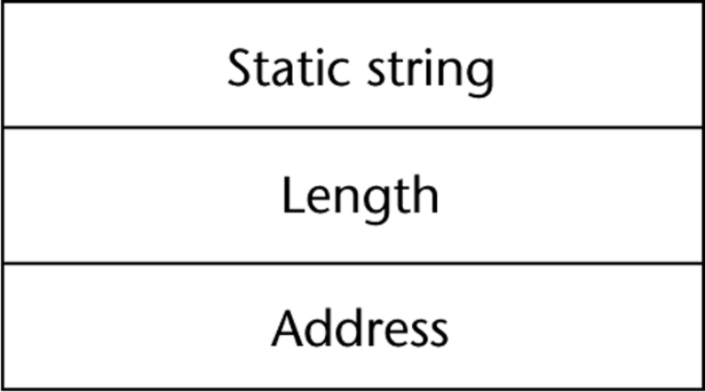
Implementation: Static length
- Static length - compile-time descriptor: name of type, length( in characters ) and address of first character
Limited dynamic length - may need a run-time descriptor for length (but not in C and C++)

Slide 14
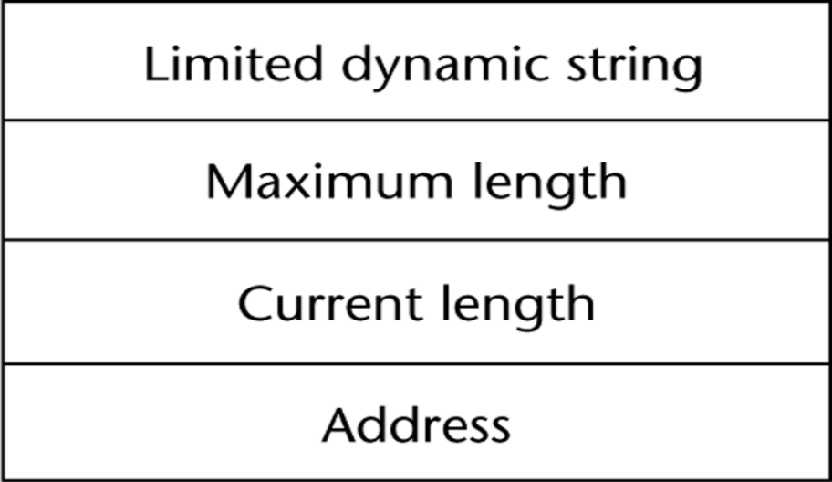
Limited dynamic strings
Limited dynamic strings require a run time descriptor to store both max length and current length
Dynamic length - need run-time descriptor( only current length); allocation/de-allocation is the biggest implementation problem.There are two possible approaches to this
- linked list, or
- adjacent storage

Slide 15
Ordinal Types ( user defined )
An ordinal type is one in which the range of possible values can be easily associated with the set of positive integers.
Enumeration Types
- one in which the user enumerates all of the possible values, which are symbolic constants
Design Issue:
Should a symbolic constant be allowed to be in more than one type definition?

Slide 16
Examples
Pascal
cannot reuse constants; they can be used for array subscripts, for variables, case selectors; NO input or output; can be compared
C and C++ -
like Pascal, except they can be input and output as integers
Java does not include an enumeration type but can be implemented as a nice class.

Slide 17
Evaluation
    Enumeration types provide advantages in both:
Aid to readability
--e.g. no need to code a color as a number
Aid to reliability
--e.g. compiler can check operations and ranges of values

Slide 18
Sub range Type
Sub range Type - an ordered contiguous subsequence of an ordinal type
Examples
Pascal - Sub range types behave as their parent types; can be used as for variables and array indices
e.g. type pos = 0 .. MAXINT;
Ada - Subtypes are not new types, just constrained existing types (so they are compatible); can be used as in Pascal, plus case constants
subtype INDEX is INTEGER range 1 .. 100;
All of operations defined for the parent type are also defined for subtype, except assignment of values out of range.

Slide 19
Implementation of user-defined ordinal types
Enumeration types are implemented by associating a nonnegative integer value with each symbolic constant in that type.
Sub range types are the parent types with code inserted (by the compiler) to restrict assignments to sub range variables

Slide 20
Arrays
An array is an aggregate of homogeneous data elements in which an individual element is identified by its position in the aggregate, relative to the first element.
Specific element of an array is identified by:
i) Aggregate name;
ii) Index (subscript):
position relative to the first element.

Slide 21
Design Issues
1. What types are legal for subscripts?
2. Are subscripting expressions in element references range checked?
3. When are subscript ranges bound?
4. When does allocation take place?
5. What is the maximum number of subscripts?
6. Can array objects be initialized?

Slide 22
Arrays and Indexes
Indexing is a mapping from indices to elements
map(array_name, index_value_list) → an element
Syntax
- FORTRAN, PL/I, Ada use parentheses
- Most others use brackets
    Example: simple_array.C
    #include <stream.h>
    void main() {
    char a[8] = "abcdefg";
    cout << a[0] << *a;
    cout << a[1] << *(a+1);
    }

Slide 23
Subscript Types
FORTRAN, C, C++, Java - int only
Pascal - any ordinal type (int, boolean, char, enum)
Ada - int or enum (includes boolean and char)
In some languages the lower bound of subscript range is fixed;
C, C++, Java - 0;
FORTRAN - 1;
In most other languages it needs to be specified by the programmer.

Slide 24
Number of subscripts
- FORTRAN I allowed up to three
- FORTRAN 77 allows up to seven
- C, C++, and Java allow just one, but elements can be arrays
- Others - no limit
Array Initialization
- Usually just a list of values that are put in the array in the order in which the array elements are stored in memory

Slide 25
Examples
1. FORTRAN - uses the DATA statement, or put the values in / ... / on the declaration
2. C and C++ - put the values in braces; can let the compiler count them
e.g.
int stuff [] = {2, 4, 6, 8};
3. Ada - positions for the values can be specified
e.g.
SCORE : array (1..14, 1..2) :=
(1 => (24, 10), 2 => (10, 7),
3 =>(12, 30), others => (0, 0));
4. Pascal and Modula-2 do not allow array initialization in the declaration section of program.

Slide 26
Slices
A slice is some substructure of an array < not a new data type>,
nothing more than a referencing mechanism
1. FORTRAN 90
INTEGER MAT (1 : 3, 1 : 3)
MAT(1 : 3, 2) - the second column
MAT(2 : 3, 1 : 3) - the second and third row
2. Ada - single-dimensioned arrays only
LIST(4..10)

Slide 27
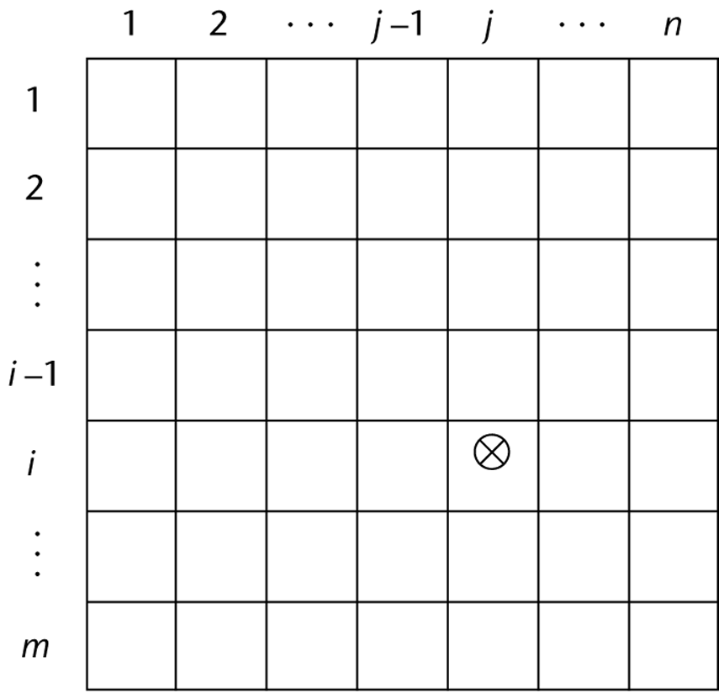
Implementation of Arrays
Access function maps subscript expressions to an address in the array - Row major (by rows) or column major order (by columns)
Column major order is used in FORTRAN, but most of other languages use row major order.
Location of the [i, j] element in a matrix.
Location[I,j] = address of a[1,1] +
( i -1)(size of row) +
(j -1)( element size).

Slide 28
Associative Arrays
An associative array is an unordered collection of data elements that are indexed by an equal number of values called keys.
Each element of a associative array is in fact a pair of entities, a key and value
- Design Issues:
1. What is the form of references to elements?
2. Is the size static or dynamic?
Associative arrays are supported by the standard class library of Java.
But the main languages which supports an associative arrays is Perl.

Slide 29
Structure and Operations in Perl (hashes)
In Perl, associative arrays are often called hashes.
- Names begin with %
- Literals are delimited by parentheses
%hi_temps = ("Monday" => 77,
"Tuesday" => 79,…);
- Subscripting is done using braces and keys
$hi_temps{"Wednesday"} = 83;
- Elements can be removed with delete
delete $hi_temps{"Tuesday"};
@hi_temp = (): empties the entire hash

Slide 30
Records
A record is a possibly heterogeneous aggregate of data elements in which the individual elements are identified by names.
First was introduced in1960 COBOL since than almost all languages support them ( except pre 90 FORTRAN).
Design Issues that are specific for records
1. What is the form of references?
2. What unit operations are defined?

Slide 31
Record Field References
1. COBOL
field_name OF record_name_1 OF ... OF record_name_n
2. Others (dot notation)
record_name_1.record_name_2. ... .record_name_n.field_name
Fully qualified references must include all record names
Elliptical references allow leaving out record names as long as the reference is unambiguous ( COBOL and PL/I)
Pascal and Modula-2 provide a with clause to abbreviate references
In C and C++, individual fields of structures are accessed by member selection operators “.” and “->“.

Slide 32
Example
structure type in C and C++, program simple_struct.C
#include <stream.h>
struct student {
int ssn;
char grade;
};
void main() {
struct student john;
struct student *p_john;
john.grade = 'A';
p_john = &john;
cout << p_john → grade << endl;
}

Slide 33
Record Operations
1. Assignment
- Pascal, Ada, and C allow it if the types are identical
2. Initialization
- Allowed in Ada, using an aggregate constant
3. Comparison
- In Ada, = and /=; one operand can be an aggregate constant
4. MOVE CORRESPONDING
- In COBOL - it moves all fields in the source record to fields with the same names in the destination record
Comparing records and arrays
1. Access to array elements is much slower than access to record fields, because subscripts are dynamic (field names are static)
2. Dynamic subscripts could be used with record field access, but it would disallow type checking and it would be much slower

Slide 34
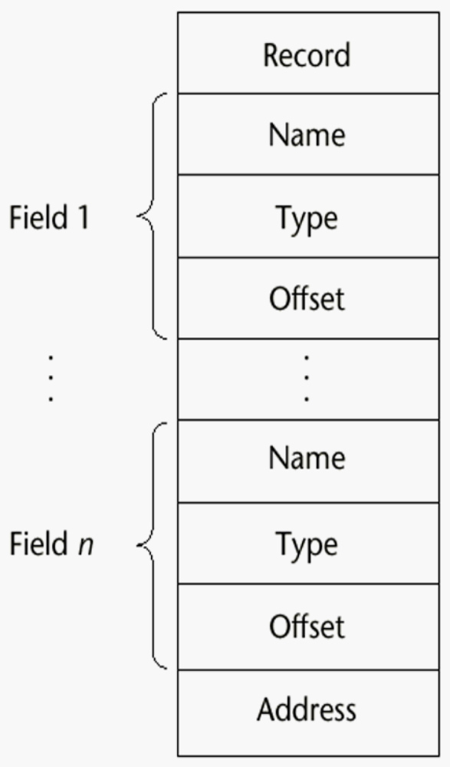
Implementation of Record Type
The fields of record are stored in adjacent memory locations. The offset address relative to beginning is associated with each field.The field accesses are handled by using this offsets.

Slide 35
Unions
A union is a type whose variables are allowed to store different type
values at different times during execution
Design Issues for unions:
1. What kind of type checking, if any, must be done?
2. Should unions be integrated with records?
Examples:
1. FORTRAN - with EQUIVALENCE in C or C++ construct union is used
(free unions)
2. Algol 68 - discriminated unions
- Use a hidden tag to maintain the current type
- Tag is implicitly set by assignment
- References are legal only in conformity clauses
(see book example p. 231)
- This runtime type selection is a safe method of accessing union objects

Slide 36
Sets
A set is a type whose variables can store unordered collections of distinct values from some ordinal type called base type
Design Issue:
What is the maximum number of elements in any set base type?
Examples:
1. Pascal
- No maximum size in the language definition (not portable, poor
writability if max is too small)
- Operations: union (+), intersection (*), difference (-), =, < >, superset
2. Java includes a class for set operations

Slide 37
Sets
Evaluation
- If a language does not have sets, they must be simulated, either with enumerated types or with arrays
- Arrays are more flexible than sets, but have much slower operations
Implementation
- Usually stored as bit strings and use logical operations for the set operations

Slide 38
Pointers
A pointer type is a type in which the range of values consists of memory addresses and a special value, nil (or null) The value nil indicates that a pointer cannot currently be used to reference another object. In C and C++, a value 0 is used as nil.
Uses:
1. Addressing flexibility ( indirect addressing )
2. Dynamic storage management ( access to heap)
Design Issues:
1. What is the scope and lifetime of pointer variables?
2. What is the lifetime of heap-dynamic variables?
3. Are pointers restricted to pointing at a particular type?
4. Are pointers used for dynamic storage management, indirect addressing, or both?
5. Should a language support pointer types, reference types, or both?

Slide 39
Fundamental Pointer Operations
1. Assignment: Sets a pointer variable to the address of some object.
2. References (explicit versus implicit dereferencing)
Obtaining the value of the memory cell whose address
is in the memory cell to which the pointer variable
is bound to.
In C and C++, dereferencing is specified by prefixing a identifier of a pointer type by the dereferencing operator (*).

Slide 40
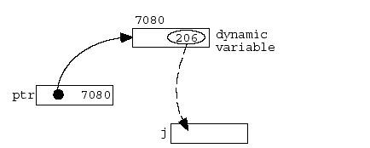
Example
(Example in C++)
int j;
int *ptr; // pointer to integer variables
...
j = *ptr;
Address-of operator (&): Produces the address of an object.

Slide 41
Problems with pointers
1. Dangling pointers (dangerous)
- A pointer points to a heap-dynamic variable that has been de-allocated
- Creating one:
a. Allocate a heap-dynamic variable and set a pointer to point at it
b. Set a second pointer to the value of the first pointer
c. De-allocate the heap-dynamic variable, using the first pointer
(Example 1) dangling.C
#include <stream.h>
void main() {
int *x, *y;
x = new int;
*x = 777;
delete x;
y = new int;
*y = 999;
cout << *x << endl;
}

Slide 42
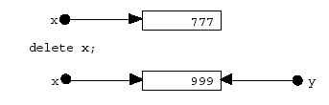
Example (C++)
dangling.C
#include <stream.h>
void main() {
int *x, *y;
x = new int;
*x = 777;
delete x;
y = new int;
*y = 999;
cout << *x << endl;
}
Example 2
int *x;
...
{
int y = 1;
x = &y;
}
...
cout << *x << endl;
// We don't know what's in *x

Slide 43
Lost Heap-Dynamic Variables
- A heap dynamic variable that is no longer referenced by
any program pointer (wasteful)
- Creating one:
a. Pointer p1 is set to point to a newly created heap-dynamic variable
b. p1 is later set to point to another newly created heap-dynamic variable
- The process of losing heap-dynamic variables is called memory leakage

Slide 44
Reference Types
C++ has a special kind of pointers Reference Types
which is constant pointers that are implicitly
de-referenced
Used for formal parameters in function definitions
Advantages of both pass-by-reference and pass-by
value
float stuff[100];
float *p;
p = stuff;
*(p+5) is equivalent to stuff[5] and p[5]
*(p+i) is equivalent to stuff[i] and p

Slide 45
Java
Java - Only references
- No pointer arithmetic
- Can only point at objects (which are all on the heap
- No explicit deallocator (garbage collection is used
- Means there can be no dangling references
- Dereferencing is always implicit

Slide 46
Implementation of Pointer and Reference Types
In most larger computers, pointers and references
are single values stored in either two or four-byte
Memory cells depending on the size of the address
space of machine address.
Microcomputers
(thus are based on Intel microprocessors which uses two part addresses: segment and offset) pointers and references are implemented as pair of 16 bit words, one for each part.

Slide 47
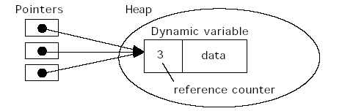
Garbage collection
Reference counter (eager approach): Each memory cell is associated with a counter which stores the number of pointers that currently point to the cell. When a pointer is disconnected from a cell, the counter is decremented by 1 if the reference counter reaches 0, meaning the cell has become a garbage, the cell is returned to the list of available space.

Slide 48
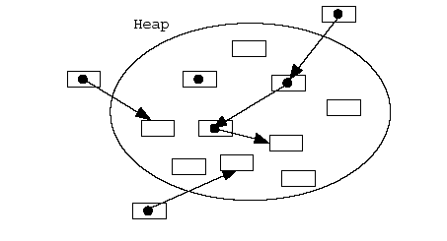
Garbage collection
(lazy approach): Waits until all available cells have
been allocated. A garbage collection process starts
by setting indicators of all the cells to indicate
they are garbage. Then every pointer in the program
is traced, and all reachable cells are marked as
not being garbage.

Slide 49
Chapter 7
Expressions and Assignment Statements
Arithmetic Expressions
Overloaded Operators
Type Conversations
Relational and Boolean Expressions
Short Circuit Evaluation
Assignment Statements
Mixed Mode Assignments
Notes:
The slides for this text are organized into chapters. This lecture covers Chapter 1.
Chapter 1: Introduction to Database Systems
Chapter 2: The Entity-Relationship Model
Chapter 3: The Relational Model
Chapter 4 (Part A): Relational Algebra
Chapter 4 (Part B): Relational Calculus
Chapter 5: SQL: Queries, Programming, Triggers
Chapter 6: Query-by-Example (QBE)
Chapter 7: Storing Data: Disks and Files
Chapter 8: File Organizations and Indexing
Chapter 9: Tree-Structured Indexing
Chapter 10: Hash-Based Indexing
Chapter 11: External Sorting
Chapter 12 (Part A): Evaluation of Relational Operators
Chapter 12 (Part B): Evaluation of Relational Operators: Other Techniques
Chapter 13: Introduction to Query Optimization
Chapter 14: A Typical Relational Optimizer
Chapter 15: Schema Refinement and Normal Forms
Chapter 16 (Part A): Physical Database Design
Chapter 16 (Part B): Database Tuning
Chapter 17: Security
Chapter 18: Transaction Management Overview
Chapter 19: Concurrency Control
Chapter 20: Crash Recovery
Chapter 21: Parallel and Distributed Databases
Chapter 22: Internet Databases
Chapter 23: Decision Support
Chapter 24: Data Mining
Chapter 25: Object-Database Systems
Chapter 26: Spatial Data Management
Chapter 27: Deductive Databases
Chapter 28: Additional Topics

Slide 50
Arithmetic Expressions
We have learned that variables are abstraction of memory cells in a computer
Abstraction of computation taking place in a CPU.
Corresponding to micro-operations executed in an arithmetic
logic unit (ALU), there are arithmetic and logical expressions.
Their evaluation was one of the motivations for the
development of the first programming languages
Arithmetic expressions consist of operators, operands, parentheses, and function calls

Slide 51
Design issues for arithmetic expressions
1. What are the operator precedence rules?
2. What are the operator associatively rules?
3. What is the order of operand evaluation?
4. Are there restrictions on operand evaluation side
effects?
5. Does the language allow user-defined operator
overloading?
6. What mode mixing is allowed in expressions?

Slide 52
Operators and operands
An expression consists of operators and operands. Operators
specify actions to be performed on data. Data processed by
an operator are called operands. Operators taking a single
operand is called unary;
++a (unary)
those taking two operators are called binary.
a + b (binary)
A ternary operator has three operand C, C++, and Java (?:)
average = (count == 0)? 0 : sum / count
In most imperative languages, binary operators are infix.

Slide 53
Operator Precedence
Def: The operator precedence rules for expression evaluation define the order in which “adjacent operators of different precedence levels are evaluated(“adjacent” means they are separated by at most one operand)
Typical precedence levels
1. parentheses
2. unary operators
3. ** (if the language supports it) ( exponentiation)
4. *, /
5. +, -
Language dependent ( see book for details)

Slide 54
Associatively rules
Def: The operator associatively rules for expression evaluation define the order in which adjacent operators with the same precedence level are evaluated
Typical associatively rules:
- usually left to right
- APL is different; all operators have equal precedence and all operators associate right to left
Precedence and associatively rules can be overridden with parentheses
Example:
A + B – C – D =

Slide 55
Operand evaluation order
The process:
1. Variables: just fetch the value
2. Constants: sometimes a fetch from memory; sometimes the constant is in the machine language instruction
3. Parenthesized expressions: evaluate all operands and operators first
4. Function references: The case of most interest.
- Order of evaluation is crucial
Functional side effects - when a function changes a parameter or a non-local variable

Slide 56
Operator Overloading
- Some is common (e.g., + for int and float)
- Some is potential trouble (e.g., * in C and C++)
- Loss of compiler error detection
Can be avoided by introduction of new symbols
C++ allows user-defined overloaded operators
C++ a few operators cannot be overloaded
class or structure member (.)
scope resolution operator (::)
Potential problems:
- Users can define nonsense operations
- Readability may suffer

Slide 57
Implicit Type Conversions
A narrowing conversion is one that converts an object to a type that cannot include all of the values of the original type
A widening conversion is one in which an object is converted to a type that can include at least approximations to all of the values of the original type
A mixed-mode expression is one that has operands of different types
A coercion is an implicit type conversion
- The disadvantage of coercions:
- They decrease in the type error detection ability of
the compiler
- In most languages, all numeric types are coerced in expressions, using widening conversions

Slide 58
Relational Expressions
Use relational operators and operands of various types
Evaluate to some Boolean representation
Relational operators always have lower precedence than arithmetic Operations
a + 1 > 2*b
Boolean Expressions
Operands are Boolean and the result is Boolean
FORTRAN 77 FORTRAN 90 C Ada
  .AND. and && and
  .OR. or || or
  .NOT. not ! not
  C has no Boolean type--it uses int type with for false and
  nonzero for true

Slide 59
Short Circuit Evaluation
    A short-circuit evaluation of an expression is one in which the result is determined without evaluating all of the operands and/or operators.
    index := 1;
    while (index <= length) and
    (LIST[index] <> value) do
    index := index + 1
    C, C++, and Java: use short-circuit evaluation for the usual Boolean operators (&& and ||), but also provide bitwise Boolean operators that are not short circuit (& and |)

Slide 60
Assignment Statements
The general syntax of the simple assignment statement is
< target_value> <assign_operator> <expression>
The operator symbol:
1. = FORTRAN, BASIC, PL/I, C, C++, Java
2. := ALGOLs, Pascal, Modula-2, Ada
= can be bad if it is overloaded for the relational operator for equality

Slide 61
More complicated assignments
1. Multiple targets A, B = 10
2. Conditional targets (C, C++, and Java)
(first = true) ? total : subtotal = 0
3. Compound assignment operators (C, C++, and Java)
sum += next;
4. Unary assignment operators (C, C++, and Java)
a++;
When two unary operators apply to the same operand, the association is right to left
a ++ is same as (a++)

Slide 62
Assignment as an Expression
In C, C++, and Java, the assignment statement produces a result
- So, they can be used as operands in expressions
e.g. while ((ch = getchar()) != EOF) { ... }
Disadvantage
- Another kind of expression side effect often leads to expression that is hard to read and understand.
Example: a = b +( c = d/b++) – 2;
Assign b to temp
Assign b + 1 to b
Assign d/temp to c
Assign b + c to temp
Assign temp - 2 to a.

Slide 63
Mixed-Mode Assignment
- In FORTRAN, C, and C++, any numeric value can be assigned to any numeric scalar variable; whatever conversion is necessary is done
- In Pascal, integers can be assigned to reals, but reals cannot be assigned to integers (the programmer must specify whether the conversion from real to integer is truncated or rounded)
In Java, only widening assignment coercions are done one of the effective ways to increase the reliability of Java, relative to C and C++ .
- In Ada and Modula 2 there is no assignment coercion
In all languages that allow mixed-mode assignment, the coercion
takes place only after the right side expression has been
evaluated

Slide 64
Chapter 8
Statement-Level Control Structures
Compound Statements
Selection Statements
Iterative Statements
Unconditional Branching
Guarded Commands
Notes:
The slides for this text are organized into chapters. This lecture covers Chapter 1.
Chapter 1: Introduction to Database Systems
Chapter 2: The Entity-Relationship Model
Chapter 3: The Relational Model
Chapter 4 (Part A): Relational Algebra
Chapter 4 (Part B): Relational Calculus
Chapter 5: SQL: Queries, Programming, Triggers
Chapter 6: Query-by-Example (QBE)
Chapter 7: Storing Data: Disks and Files
Chapter 8: File Organizations and Indexing
Chapter 9: Tree-Structured Indexing
Chapter 10: Hash-Based Indexing
Chapter 11: External Sorting
Chapter 12 (Part A): Evaluation of Relational Operators
Chapter 12 (Part B): Evaluation of Relational Operators: Other Techniques
Chapter 13: Introduction to Query Optimization
Chapter 14: A Typical Relational Optimizer
Chapter 15: Schema Refinement and Normal Forms
Chapter 16 (Part A): Physical Database Design
Chapter 16 (Part B): Database Tuning
Chapter 17: Security
Chapter 18: Transaction Management Overview
Chapter 19: Concurrency Control
Chapter 20: Crash Recovery
Chapter 21: Parallel and Distributed Databases
Chapter 22: Internet Databases
Chapter 23: Decision Support
Chapter 24: Data Mining
Chapter 25: Object-Database Systems
Chapter 26: Spatial Data Management
Chapter 27: Deductive Databases
Chapter 28: Additional Topics

Slide 65
Levels of Control Flow
The flow of control, or execution sequence, in program can be examined at several levels:
1. Within expressions
2. Among program units
3. Among program statements
Def: Statements that provide capabilities such, selecting among alternative control flow paths or causing the repeated execution of certain collection of statements are called control statements
Def: A control structure is a control statement and the statements whose execution it controls

Slide 66
Evolution
FORTRAN I: control statements were based directly on IBM 704 hardware
Much research and argument in the1960s about the issue
goto or not having goto
One important result: It was proven that all flowcharts can be coded with only two-way selection and pretest logical loops
Language features that helps make control statement design easier is
a method of forming statement collections.
Compound statements introduced by ALGOL60 in the form of begin.. .end
A block is a compound statement that can define a new scope (with local variables)
Overall Design Question:
What control statements should a language have, beyond selection and pretest logical loops?
Whether the control structure can have multiple entry

Slide 67
Classification of Control Statements
Selection statements: Choose between two or more execution paths in a program.
Two-way selection statements:
Select one of two execution paths—if-then-else statements.
Design issues
What is the form and type of the expression that controls the selection
Can a single statement, a sequence of statements, or a compound statement be selected
How should be meaning of nested selectors be specified

Slide 68
Nesting Selectors
Consider the following Java like code:
if (sum == 0)
if ( count == 0)
result = 0 ;
else
result = 1;
In Java, as in many other imperative languages, the semantics of language specify that the else clause is always paired with the most recent unpaired then clause.
In ALGOL 60 it was done by using syntax; an if must be nested in a then clause, it must be placed in a compound statement. This means that if statement is not allowed to be nested inside of than clause directly.

Slide 69
In ALGOL 60 it was done by using syntax; If an if must be nested in a then clause, it must be placed in a compound statement. This means that if statement is not allowed to be nested inside of than clause directly.
if sum = 0 then
begin
if count = 0 then
result := 0 ;
else
result: = 1;
end
if sum = 0 then
begin
if count = 0 then
result := 0 ;
end
else
result: = 1;
An alternative to ALGOL 60’s design is to require special
closing words for then and else clauses (if end if) ADA

Slide 70
Multiple selection constructs
Multiple selection construct allows the selection of one or any number of statements or statement groups switch construct. The original form came from FORTRAN
Design issues for multiple way selectors
What is the type and form of expression that controls the selection?
May single statement, sequence of statements or compound statement be selected?
Is the entire construct encapsulated in a syntactic structure?
Is execution flow through the structure restricted to include just one selectable segment?
How should unrepresented selector expression values be handled, if at all?

Slide 71
Early Multiple Selectors
1. FORTRAN arithmetic IF (a three-way selector)
Bad aspects:
- Not encapsulated (selectable segments could
be anywhere)
- Segments require GOTOs
2. FORTRAN computed GOTO and assigned GOTO

Slide 72
Modern Multiple Selectors
Pascal case
case expression of
constant_list_1 : statement_1;
...
constant_list_n : statement_n
end
Design choices:
1. Expression is any ordinal type (int, boolean, char, enum)
2. Segments can be single or compound
3. Construct is encapsulated
4. Only one segment can be executed per execution of the construct
5. Result of an unrepresented control expression value is undefined
- Many dialects now have otherwise or else clause

Slide 73
The C and C++ switch
switch (expression) {
constant_expression_1 :
statement_1;
...
constant_expression_n :
statement_n;
[default:
statement_n+1]
}
Design Choices: (for switch)
1. Control expression can be only an integer type
2. Selectable segments can be statement sequences, blocks, or compound statements
4. Any number of segments can be executed in one execution of the construct (there is no implicit branch at the end of selectable segments)
5. default clause is for unrepresented values (if there is no default, the whole statement does nothing)

Slide 74
Example C++
#include <stream.h>
int days_in_month(int month) {
int days;
switch (month) {
case 2:
days = 29;
break;
case 4: case 6: case 9: case 11:
days = 30;
break;
default:
days = 31;
}
return days;
}
void main() {
cout << days_in_month(3) << endl;
}

Slide 75
Iterative Statements
The repeated execution of a statement or compound statement is accomplished either by iteration or recursion; here we look at iteration, because recursion is unit-level control
General design Issues for iteration control statements:
1. How is iteration controlled?
2. Where is the control mechanism in the loop?
The primary possibilities for iteration control are logical, counting or combination of this two. Main choices for the location of the control mechanism are top or bottom of the loop.( posttest, or pretest)

Slide 76
Counter-Controlled Loops
Design Issues:
1. What is the type and scope of the loop var?
2. What is the value of the loop var at loop termination?
3. Should it be legal for the loop var or loop parameters to be changed in the loop body, and if so, does the change affect loop control?
4. Should the loop parameters be evaluated only once, or once for every iteration?

Slide 77
C- Syntax
for ([expr_1] ; [expr_2] ; [expr_3]) statement
The expressions can be whole statements, or statement sequences, with the statements. If the second expression is absent, it is an infinite loop
C Design Choices:
1. There is no explicit loop var
2. Irrelevant
3. Everything can be changed in the loop
4. Pretest
5. The first expression is evaluated once, but the other two are evaluated with each iteration
- This loop statement is the most flexible

Slide 78
C++ and Java
C++ : Differs from C in two ways:
1. The control expression can also be Boolean
2. The initial expression can include variable definitions
(scope is from the definition to the end of the function in which it is defined)
Java: Differs from C++ in two ways:
1. Control expression must be Boolean
2. Scope of variables defined in the initial expression is only the loop body

Slide 79
Logically-Controlled Loops
Design Issues:
1. Pretest or posttest?
2. Should this be a special case of the counting loop statement (or a separate statement)?
- Language Examples:
1. Pascal has separate pretest and posttest logical loop statements (while-do and repeat-until)
2. C and C++ also have both, but the control expression for the posttest version is treated just like in the pretest case (while - do and do - while)
3 Java is like C, except the control expression must be Boolean (and the body can only be entered at the beginning)

Slide 80
User-Located Loop Control Mechanisms
Design issues:
1. Should the conditional be part of the exit?
2. Should the mechanism be allowed in an already controlled loop?
3. Should control be transferable out of more than one loop?
Examples:
1. Ada - conditional or unconditional; for any loop;
any number of levels
for ... loop LOOP1:
... while ... loop
exit when ... ...
... LOOP2:
end loop for ... loop
...
exit LOOP1 when ..
...
end loop LOOP2;
...
end loop LOOP1;

Slide 81
User-Located Loop Control Mechanisms
C , C++, and Java - break
Unconditional; for any loop or switch; one level only (Java’s can have a label)
There is also a continue statement for loops; it skips the remainder of this iteration, but does not exit the loop
FORTRAN 90 - EXIT
Unconditional; for any loop, any number of levels
FORTRAN 90 also has CYCLE, which has the same semantics as C's continue

Slide 82
Iteration Based on Data Structures
Concept: use order and number of elements of some data structure to control iteration
- Control mechanism is a call to a function that returns the next element in some chosen order,if there is one; else exit loop
C's for can be used to build a user-defined iterator
e.g. for (p=hdr; p; p=next(p)) { ... }
Perl has a built-in iterator for arrays and hashes
e.g.,
foreach $name (@names) { print $name }

Slide 83
End of Lecture

